Slide 1



Day 2 Trainer Playbook
Sean Wong
2025/08/05

Slide 2
01.
02.
Goals & Kickoff
Models & Migrations
03.
04.
Contents
Admin & Shell
Views & Templates
05.
Relationships

Slide 3
Contents
01.
02.
Lab & Checklist
Quiz & Wrap

Slide 4


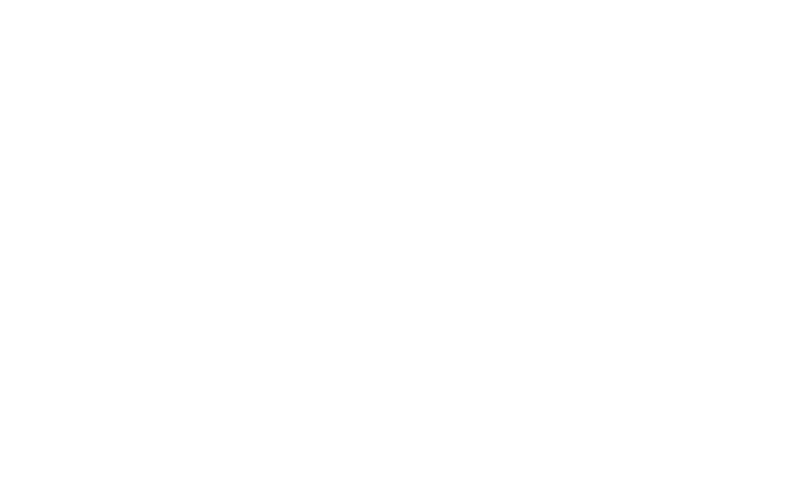
Goals & Kickoff
01

Slide 5


Day 2 Objectives
Session Mission & Agenda
By the end of Day 2, learners will understand Django’s ORM and models, create and migrate models, use the Django Admin interface, perform CRUD operations, display model data in templates, and implement relationships between models.
Duration
The session is designed to last approximately 3 hours, with a detailed breakdown of each segment to ensure comprehensive coverage of all topics.
Recap of Day 1
Quickly review key concepts from Day 1, including project and app structure, views and URL routing, and templates to refresh learners' memory and set the stage for Day 2.

Slide 6
Models & Migrations
02

Slide 7



Definition
Benefits
Models are Python classes that define the structure of database tables. Django’s ORM automatically translates these models into SQL, providing a powerful abstraction layer.
Using the ORM offers several benefits, including abstraction from raw SQL, enhanced security through parameterized queries, and portability across different database backends.
Model Concepts First Look

Slide 8



Migration Workflow Live
Edit/Create Model
Run migrate
Start by defining or modifying a model in your Django application. This involves specifying fields and their types, which will be translated into database columns.
Apply the generated migrations to the database using the migrate command. This updates the database schema to match your models, ensuring data consistency.
Run makemigrations
Verify Changes
Use the makemigrations command to generate migration files. These files contain the SQL necessary to update the database schema based on your model changes.
Check the db.sqlite3 file to see the applied changes. This step confirms that your database schema has been updated correctly according to the migrations.

Slide 9
Admin & Shell
03

Slide 10


Admin Panel Power-Up
Create Superuser
Use the createsuperuser command to create an admin account. This account will allow you to access the Django Admin interface and manage data without writing code.
Register Models
Navigate Admin
Register your models in the admin.py file to make them accessible via the Admin interface. This step enables adding, editing, and deleting data through a user-friendly GUI.
Log in to the /admin/ interface and start adding sample data. Ensure each learner can successfully log in and create entries to build confidence in managing data through the Admin panel.

Slide 11



ORM Queries in Shell
Interactive Queries
Open the Django shell using python manage.py shell and perform ORM queries such as objects.all(), get(), and filter(). Demonstrate creating, updating, and deleting objects to give learners hands-on experience with the ORM.

Slide 12
Views & Templates
04

Slide 13


Feeding Data to Views
Create View
Write a view function that queries the database using Post.objects.all() and passes the data to a template via the context dictionary. This step connects your models to the frontend.
URL Mapping
Map the view to a URL in your urls.py file. Ensure the URL is correctly configured to render the view and display the data in the template.

Slide 14

Template Loop Mastery
Template Basics
Create a template that loops over the passed data using {% for %} to display each post’s title, content, and creation date. This demonstrates dynamic data rendering.
Styling
Encourage learners to add simple CSS styling to enhance the visual presentation of the data. This step helps bridge the gap between backend data and frontend appearance.
Context Passing
Ensure the context dictionary is correctly passed from the view to the template. This allows the template to access and render the data dynamically.

Slide 15
Relationships
05

Slide 16

ForeignKey & ManyToMany
One-to-Many
Define a ForeignKey relationship in your Comment model to link comments to posts. This establishes a one-to-many relationship where each post can have multiple comments.
Many-to-Many
Implement a ManyToManyField in your Post model to allow tagging posts with multiple tags. This relationship enables flexible categorization of posts.

Slide 17
Lab & Checklist
06

Slide 18


Lab Build Blog Core
Migrate Models
Run makemigrations and migrate to apply the new models to the database. Verify that the schema updates correctly.
Create Models
Learners should create Post and Comment models, ensuring they understand the relationships and fields required for each model.
Admin Registration
Register the Post and Comment models in the Admin interface. Ensure learners can add sample data through the Admin panel.
Template Integration
Display posts and comments dynamically in a template. Learners should be able to see the data rendered correctly on the frontend.

Slide 19



Review Checklist
Ensure all learners have completed the following: models created and migrated, admin panel accessible and functional, ORM queries tested, templates display dynamic data, and relationships implemented.
Checkpoint Review List

Slide 20
Quiz & Wrap
07

Slide 21


Quick Quiz Challenge
Multiple Choice
Administer multiple-choice questions on model fields, ORM commands, and Admin usage to quickly assess learners' understanding of key concepts.
Short Answer
Ask learners to describe a One-to-Many relationship in their own words. This helps gauge their comprehension of relational database concepts.
Practical Task
Assign a practical task where learners add a post in the Admin interface and display it on a webpage to test their ability to integrate all learned skills.

Slide 22

Wrap-Up & Next Preview
Day 2 Summary
Recap the key concepts covered today: models, migrations, Admin interface, ORM queries, template integration, and relationships. Highlight the importance of each component in building a Django application.
Preview Day 3
Preview Day 3 topics, including forms, user input, POST requests, and validation. Encourage learners to experiment with different fields and relationships before the next session.

Slide 23

Thank You
Sean Wong
2025/08/05

